Slide 1
PyConZA 2023
SKAO MID Integration and Testing Facility (ITF)
Vhulahani Manukha and Monde Manzini, Verification Systems Engineers
6th October 2023

Slide 2
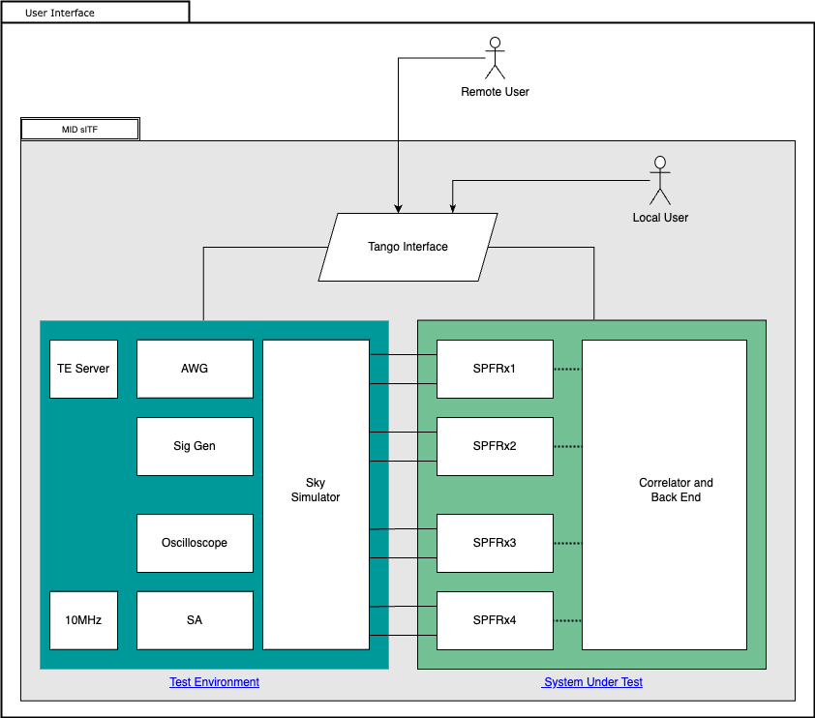

Slide 3
